Slide 1

Unleashing Tactical Advantage: Empowering Coaching Staff with Insights for Opposition Analysis
Dogan Parlak
dgnprlk@gmail.com

Slide 2
Attacking Strategies
The attacking strategies of teams can suggest either dynamic movements, such as possible decoy runs, or static positioning. Dynamic movements involve runs from outside the penalty area to the inside, while static positioning indicates minimal changes in player positions. Key player roles are determined based on zone changes during corner kick events. Dynamic Movement = DM, Static Positioning = SP.
 | Strategy | Key Player Roles
Inter | DM | CB, RCB, LF
Juventus | DM - SP | LWB, RCB
PSG | SP
Marseille | SP
Liverpool | SP
Manchester City | DM | RCB, CF, CM
Real Madrid | DM | CF, RCB, LCB
Barcelona | DM | LWB, RM

Slide 3
Defending Tactics
 | D = 1 meter | D = 1.5 meter | D = 2 meter
Inter | ZD | MM | MM
Juventus | ZD | ZD | ZD
PSG | ZD | ZD | MM-ZD
Marseille | ZD | ZD | ZD
Bayern Munich | ZD | ZD | ZD
Liverpool | ZD | ZD | MM-ZD
Manchester City | ZD | MM-ZD | MM
Real Madrid | MM-ZD | MM-ZD | MM
Barcelona | ZD | MM | MM
The defending tactics of a team can indicate either a man marking approach or a zonal defending strategy. The determination is based on the distance maintained by the defending team's players as potential man markers. As a result, the minimum distance between the defending team's players and the attacking team's players varies, with the corresponding strategy noted for each case. Man Marking = MM, Zonal Defending = ZD.

Slide 4
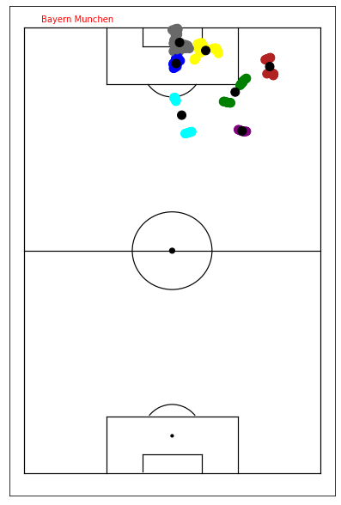
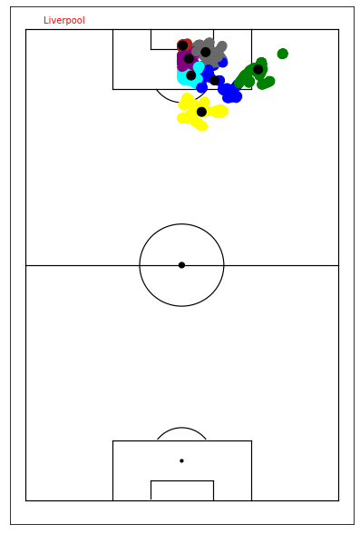
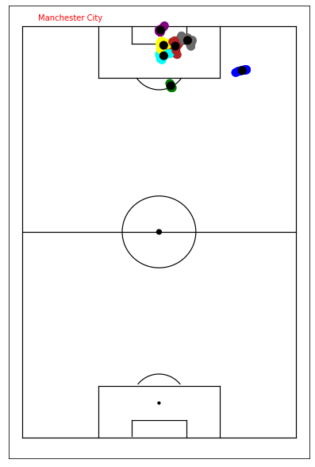
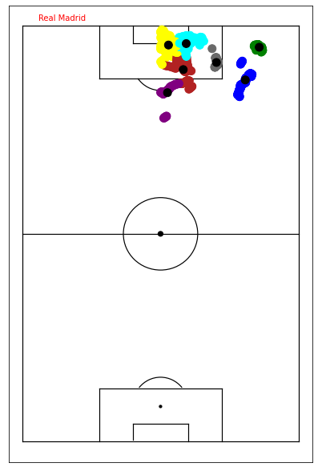
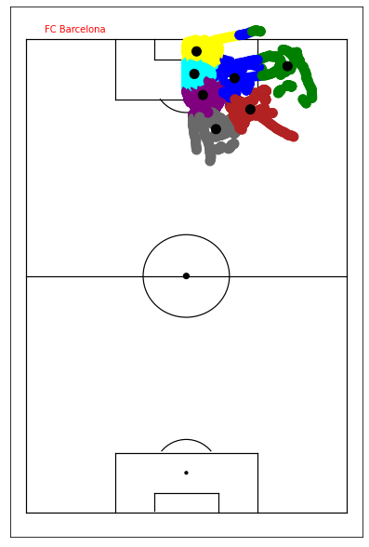
Defensive Player Positioning
The black dots represent the probable defensive positions of the team during a corner kick, while the other colors indicate observed player positions from previous matches.

Slide 5
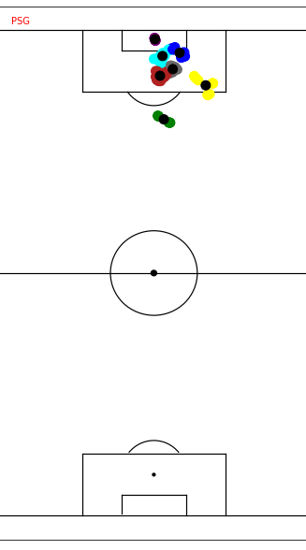
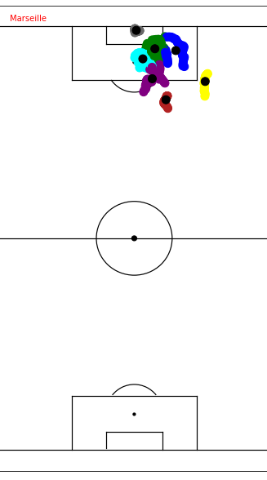
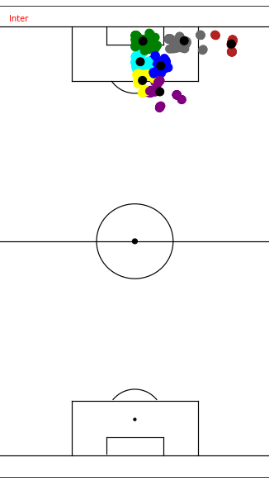
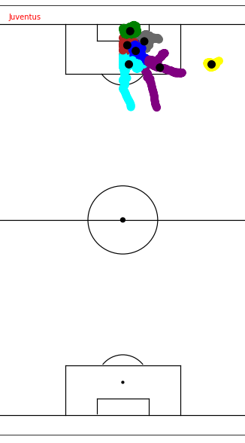
Defensive Player Positioning

